Slide 1
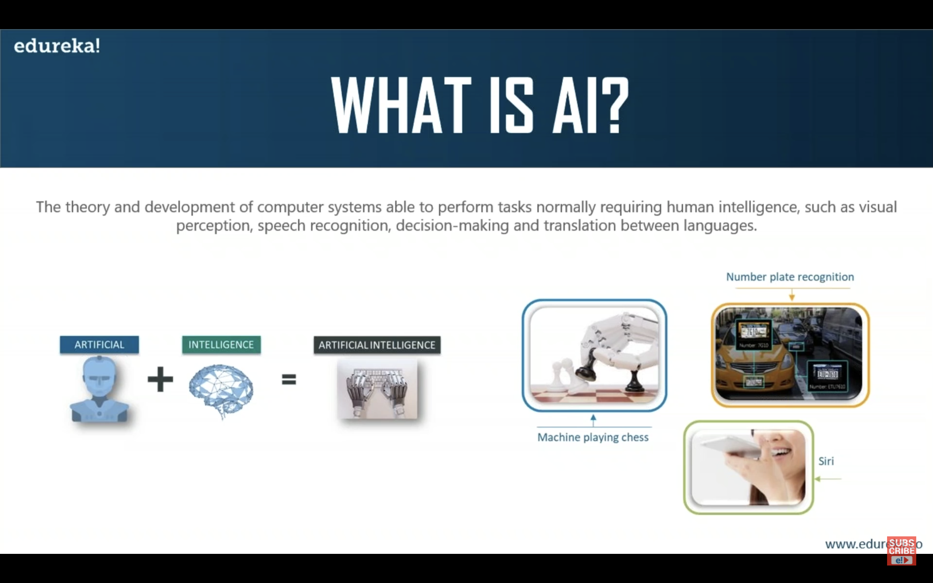
Unit 1 Introduction 2hrs
Definations

Slide 2
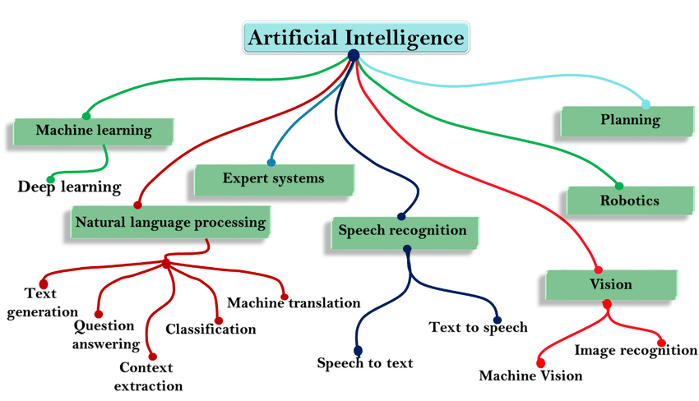

Slide 3
Goals Of AI
Reduce the amount of time needed to perform specific tasks.
Making it easier for humans to interact with machines.
Improve accuracy and speed of medical diagnoses.
Help to people to learn new info more quickly.
Improve communication between human and machine.
Effective computing is the study and developing of system that can detect, interpret, process and simulate human.

Slide 4
Challenges of AI
Data privacy and security: AI systems use large amounts of data, including personal information, which raises concerns about consent, ethical data collection, and data breaches.
Ethical decision making: As AI systems become more autonomous, questions arise about accountability, bias, and privacy.
Managing AI projects: AI projects can be costly and resource-intensive. Management requires a balance of financial, technological, and scheduling oversight.
Privacy
Data Volume
Data quality

Slide 5
AI Approaches
Acting humanly: The Turing Test approach, which aims to have AI act like a human.
Thinking humanly: The cognitive modeling approach, which aims to have AI think like a person.
Thinking rationally: The laws of thought approach, which uses symbolic logic to conclude based on logical processes.
Acting rationally: The rational agent approach, which aims to have AI act to achieve the best possible outcome for a given task.
AI marketing: Uses AI to automate data collection and behavioral targeting, to gain insights into potential buyer preferences and online behavior
Machine learning: Allows machines to learn from data without being explicitly programmed, and can make predictions or suggestions for specific situations

Slide 6
AI Techniques
Natural language processing: Analyzes natural language data and converts it into a format that machines can understand. Speech recognition is a key part of natural language processing.
Machine learning: Allows computers to learn without being explicitly programmed. Machine learning algorithms learn by absorbing large amounts of data and adjusting and improving over time.
Deep learning: Uses algorithms that simulate the human brain's neural networks. Deep learning can improve the speed and accuracy of face recognition tools.
Reinforcement learning: An agent interacts with an environment through actions, selecting an action based on the state of the environment to maximize a reward.
Supervised learning: Trains algorithms to categorize data and predict outcomes. For example, an email provider might train their spam filtering feature using data labeled spam and not spam.

Slide 7
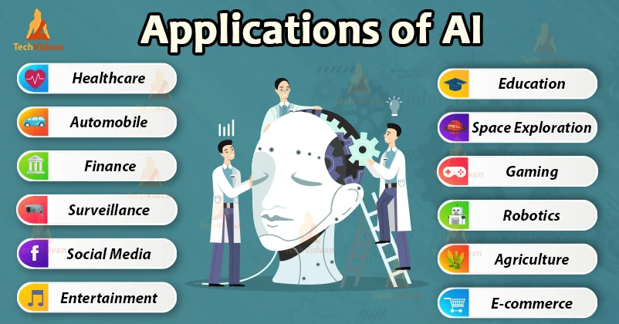
Application Of AI
AI in E-Commerce.
Education
Healthcare
Social Media
Marketing
CyberSecurity
Travel and Teansport

Slide 8
Advantage of AI
Reduction in human error
Zero risk
24*7 Availability
Digital Assistance
Daily Applications
Perform repetitive jobs
Unbiased Decesion

Slide 9
Thank You

